Slide 1
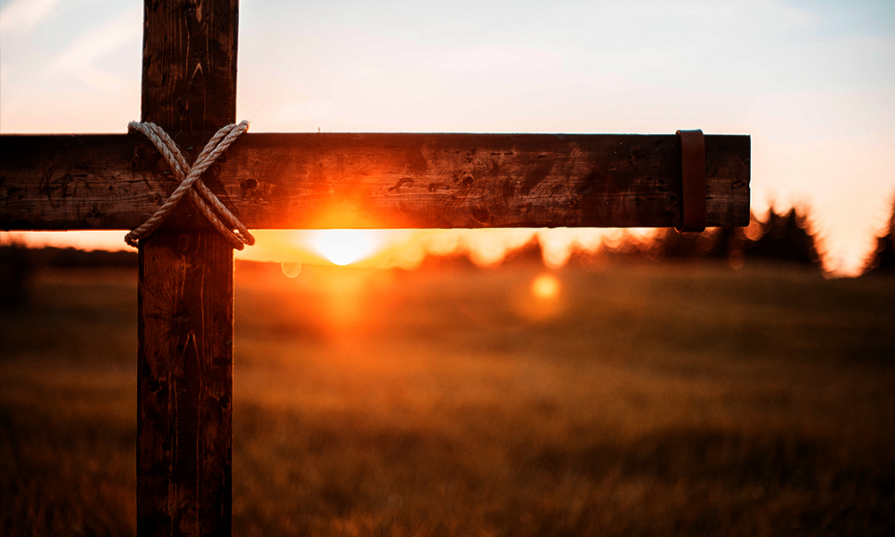
April 4, 2021
Why Did Jesus Die and Rise Again?
Romans 6:1-11

Slide 2
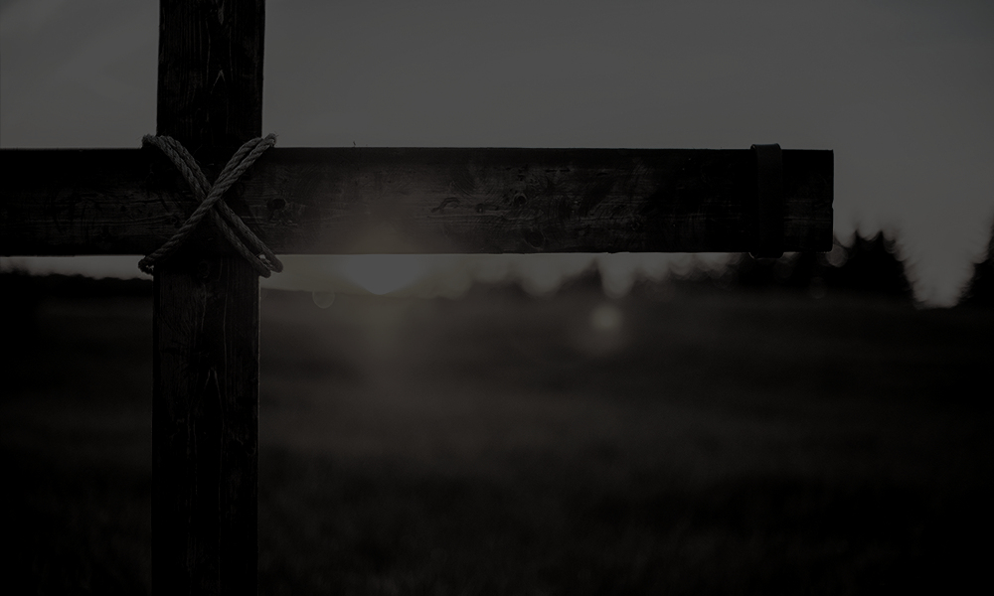
Romans 6:1-11
1 What shall we say then? Are we to continue in sin so that grace may increase? 2 May it never be! How shall we who died to sin still live in it? 3 Or do you not know that all of us who have been baptized into Christ Jesus have been baptized into His death? 4 Therefore we have been buried with Him through baptism into death, so that as Christ was raised from the dead through the glory of the Father, so we too might walk in newness of life. 5 For if we have become united with Him in the likeness of His death, certainly we shall also be in the likeness of His resurrection, 6 knowing this, that our old self was crucified with Him, in order that our body of sin might be done away with, so that we would no longer be slaves to sin; 7 for he who has died is freed from sin. 8 Now if we have died with Christ, we believe that we shall also live with Him, 9 knowing that Christ, having been raised from the dead, is never to die again; death no longer is master over Him. 10 For the death that He died, He died to sin once for all; but the life that He lives, He lives to God. 11 Even so consider yourselves to be dead to sin, but alive to God in Christ Jesus.

Slide 3
Romans 10:9
that if you confess with your mouth Jesus as Lord,
and believe in your heart that God raised Him from the dead, you will be saved…

Slide 4
Romans 6:4-5
4 Therefore we have been buried with Him through baptism into death, so that as Christ was raised from the dead through the glory of the Father, so we too might walk in newness of life. 5 For if we have become united with Him in the likeness of His death, certainly we shall also be in the likeness of His resurrection…

Slide 5
The Big Idea
Because Jesus literally and physically rose from the dead, there are present and transformational realities and responses for the genuine believer

Slide 6
The Explanation of Sanctification ^{(6:1-4)}
The Accusation ^{(6:1-2)}
The Argument ^{(6:3-4)}

Slide 7
1 Corinthians 12:13
For by one Spirit we were all baptized into one body, whether Jews or Greeks, whether slaves or free, and we were all made to drink of one Spirit.

Slide 8
Galatians 3:27
For all of you who were baptized into Christ have clothed yourselves with Christ.

Slide 9
Romans 6:4
Therefore we have been buried with Him through baptism into death, so that as Christ was raised from the dead through the glory of the Father, so we too might walk in newness of life.

Slide 10
Ezekiel 36:26-27
26 Moreover, I will give you a new heart and put a new spirit within you; and I will remove the heart of stone from your flesh and give you a heart of flesh. 27 I will put My Spirit within you and cause you to walk in My statutes, and you will be careful to observe My ordinances.

Slide 11
The Experience of Sanctification ^{(6:5-11)}
Even so consider yourselves to be dead to sin, but alive to God in Christ Jesus (Romans 6:11)
The Consideration ^{(6:11)}
United with Christ ^{(6:3-5)}
The Crucifixion of the Old Self ^{(6:6a)}
No longer Slaves to Sin ^{(6:6b-7)}
Dead to sin and alive to God ^{(6:8-10)}

Slide 12
What are we to “know”?
We are to know we have been baptized [immersed] into the death of Christ. (Romans 6:3 - Or do you not know that all of us who have been baptized into Christ Jesus have been baptized into His death?)
We are to know that our old self was crucified with Christ (Romans 6:6 - knowing this, that our old self was crucified with Him, in order that our body of sin might be done away with, so that we would no longer be slaves to sin…); and,
We are to know that death no longer has power or penalty over Christ (Romans 6:9 - knowing that Christ, having been raised from the dead, is never to die again; death no longer is master over Him.)

Slide 13
1 Peter 3:18
For Christ also died for sins once for all, the just for the unjust, so that He might bring us to God, having been put to death in the flesh, but made alive in the spirit;

Slide 14
The Big Idea
Because Jesus literally and physically rose from the dead, there are present and transformational realities and responses for the genuine believer

Slide 15
April 4, 2021
Why Did Jesus Die and Rise Again?
Romans 6:1-11

